Slide 1
Did your application impress? What might influence the decision for a call back?
A data analytics project by Miguel Visbal and Peter Kellogg

Slide 2
What is a call back?
Why do we want one?
It is not a job offer, but a big step to getting closer to landing a job
It is a positive sign: getting a callback confirms you did well enough on your first round that the prospective employer wants to see more.

Slide 3
Details about this data set:
Constructed to understand the influence of race and gender on job application callback rates
These researchers randomly generated realistic resumes to go out to a job posting
High quality or low quality, each resume was randomly assigned to a name communicating the individuals’ gender and race.
This study was conducted in Boston and Chicago for several months in 2001 and 2002, using job postings from those areas.

Slide 4
Our analysis:
Gender
Call Backs
Race
Resume Quality

Slide 5
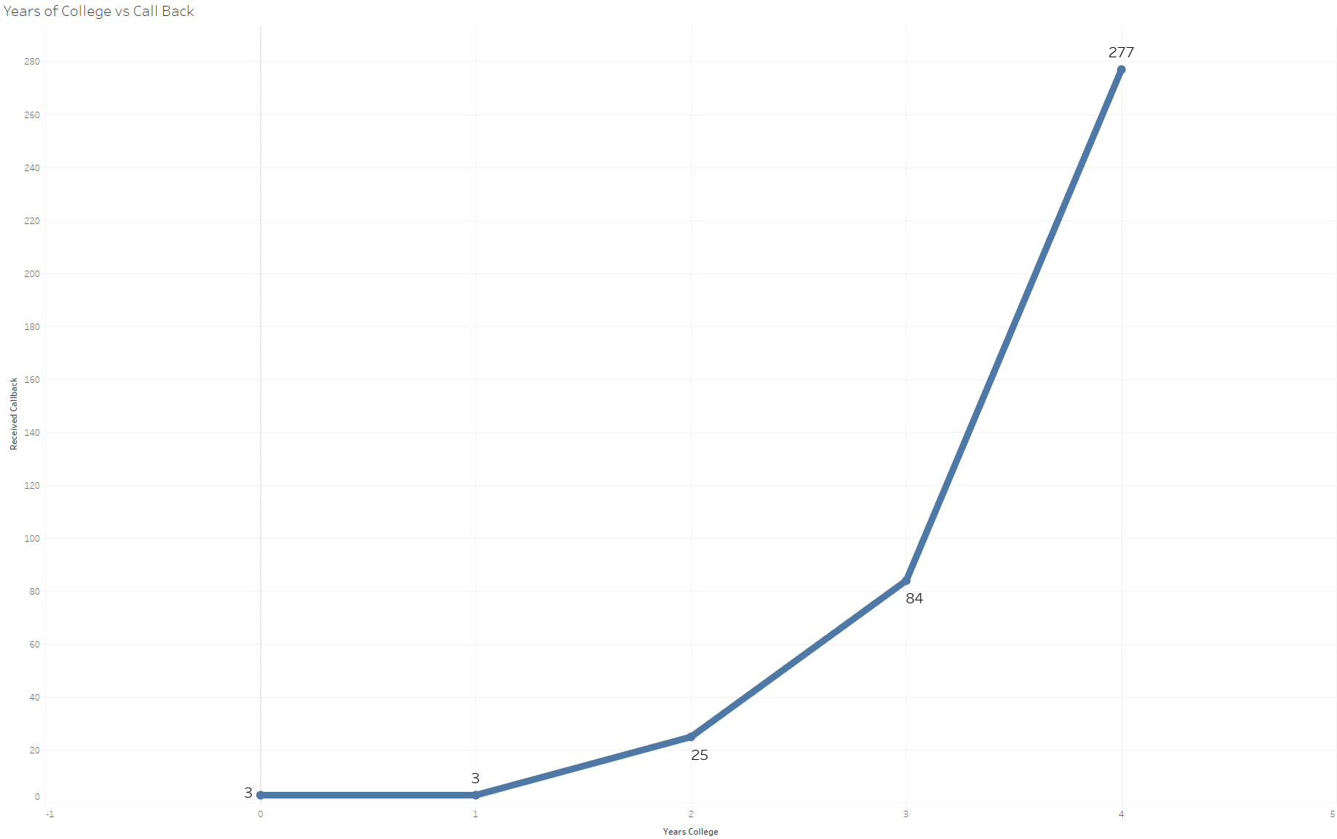
Call Back vs Years in College

Slide 6
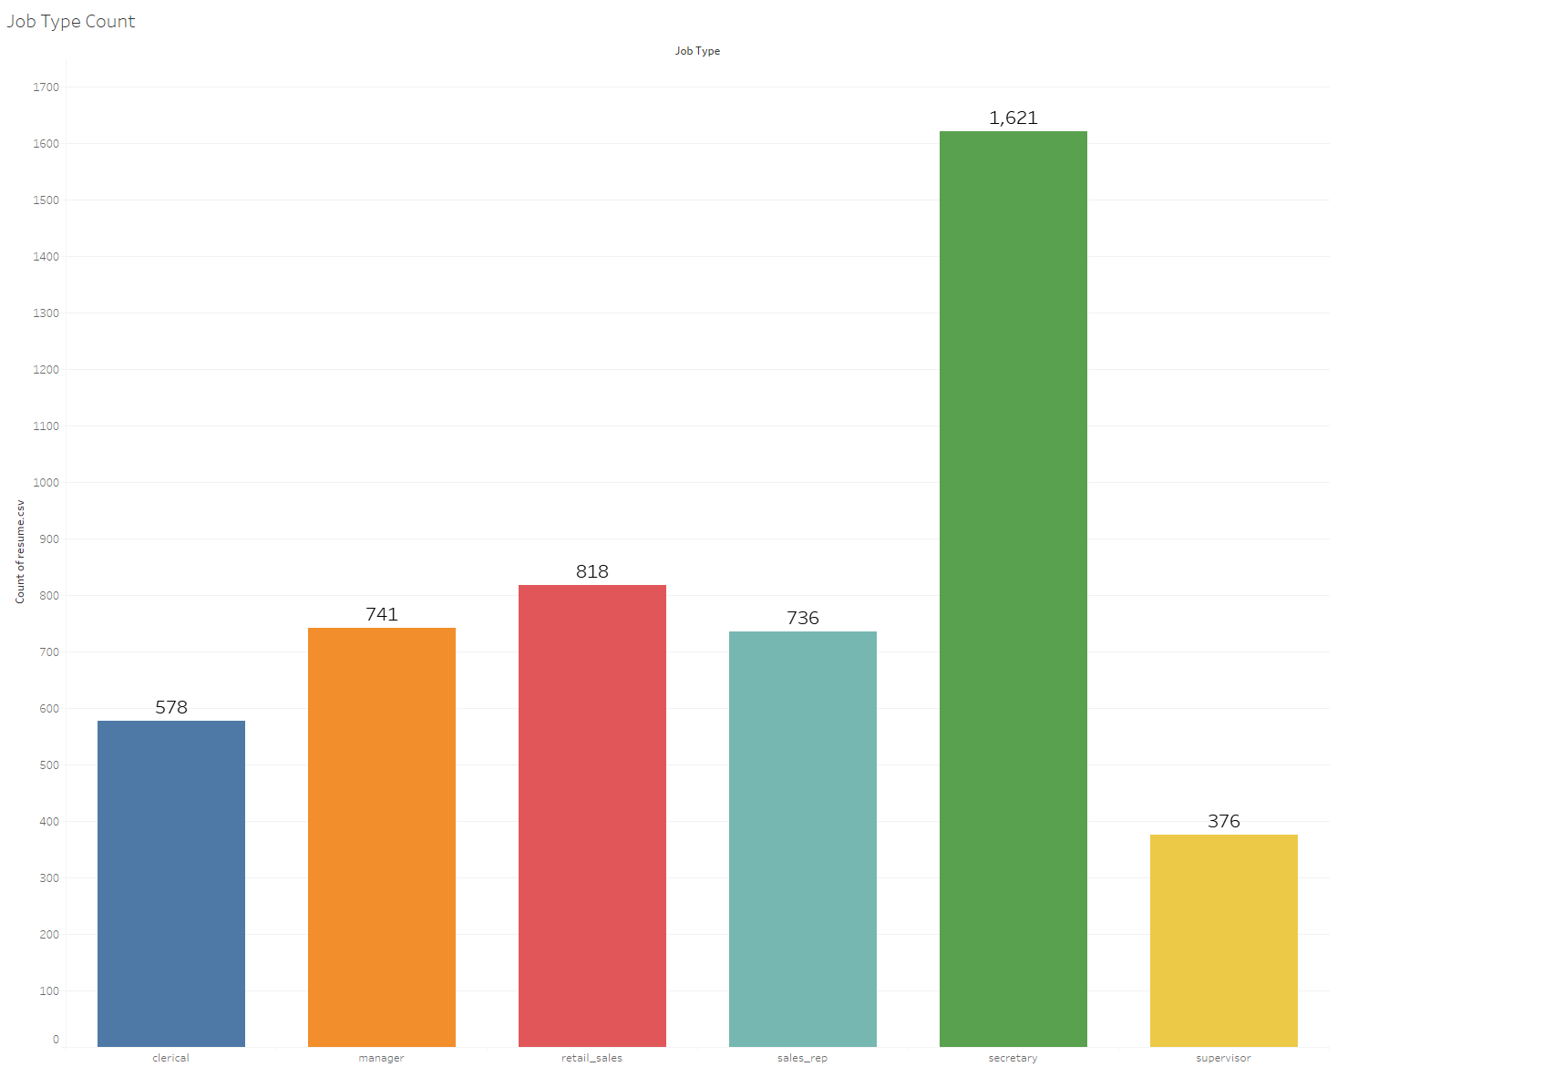
Job Type Count

Slide 7
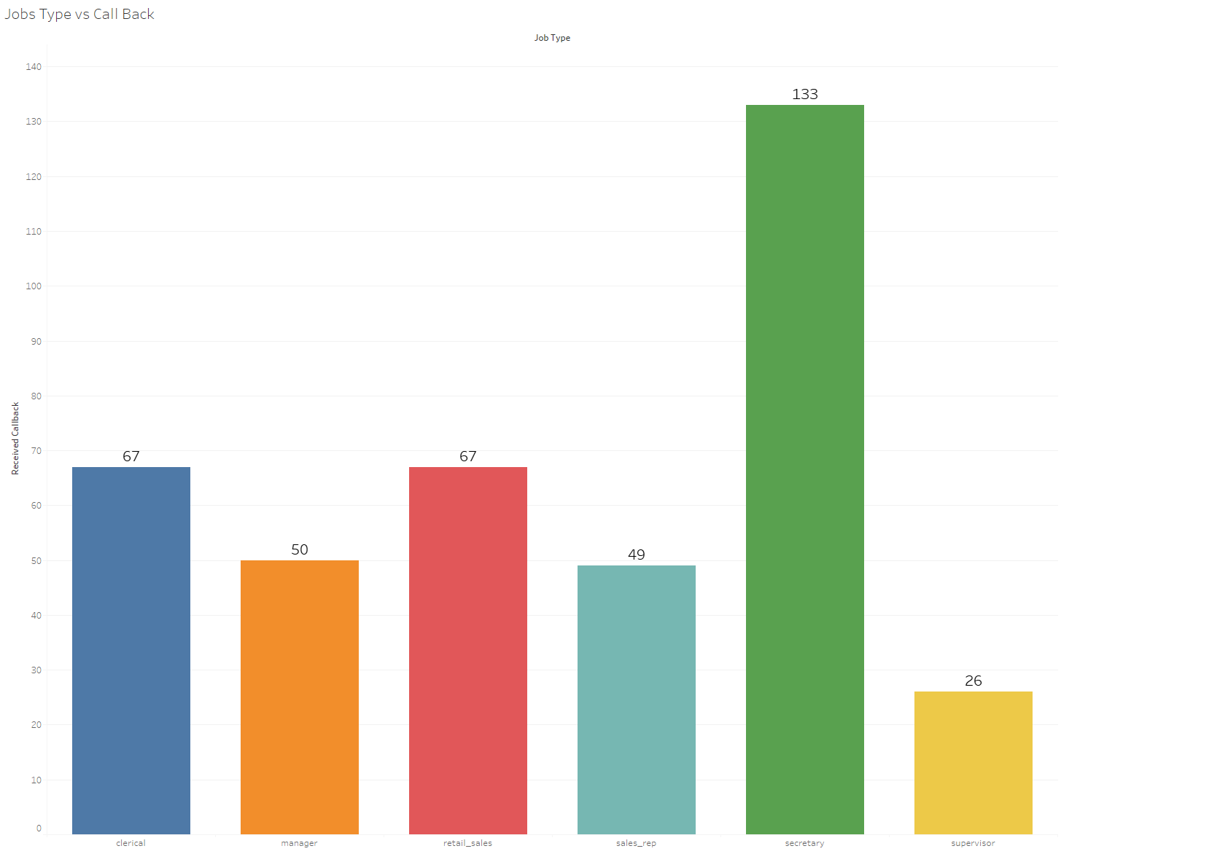
Job Type vs Call Back

Slide 8
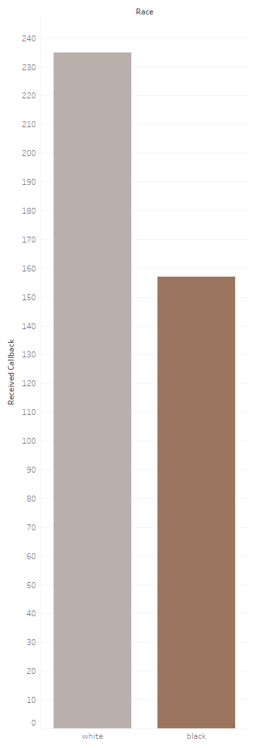
149.68%
Call Back Factor: Race
Notes:
White applicants were 149.68% more likely to get a call back as compared to black applicants

Slide 9
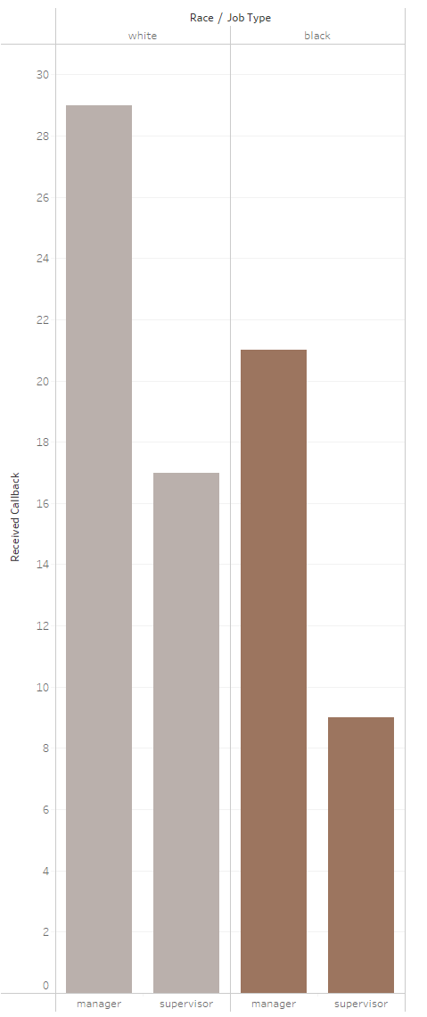
153.33%
Call Back Factor: Race + Position
Notes:
White applicants were 153.33% more likely to receive a call back in manager positions than black applicants

Slide 10
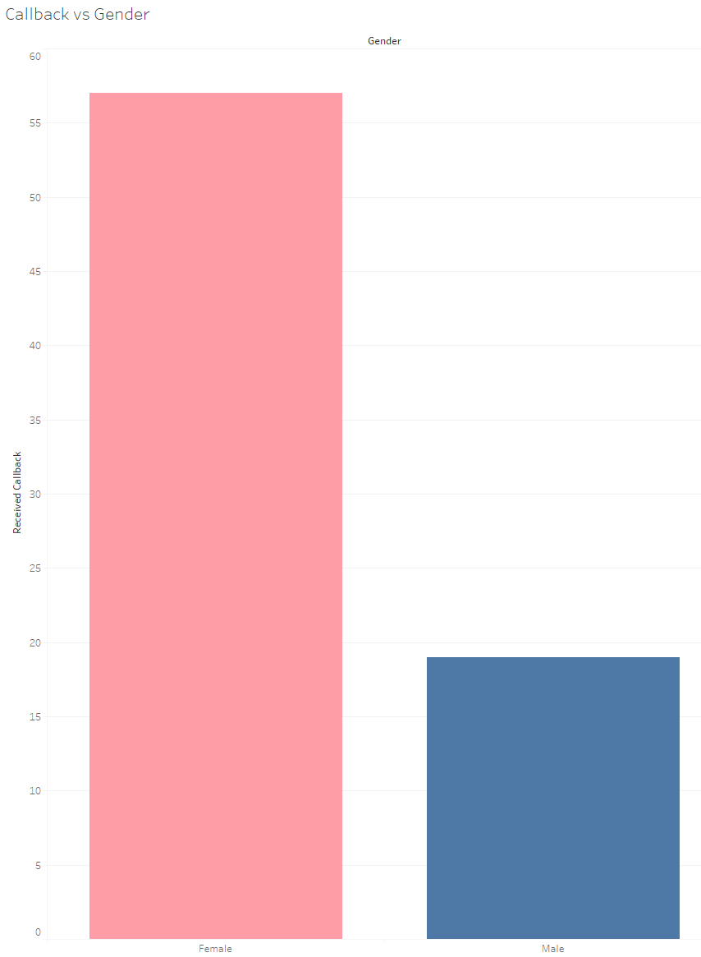
372.29%
Call Back Factor: Gender

Slide 11
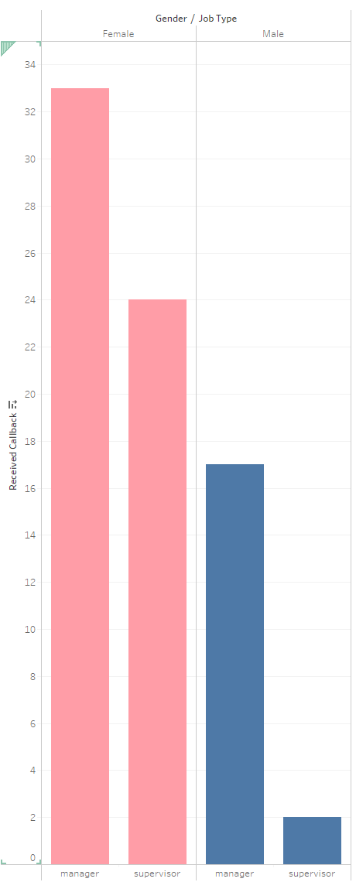
300.00%
Call Back Factor: Gender + Position

Slide 12
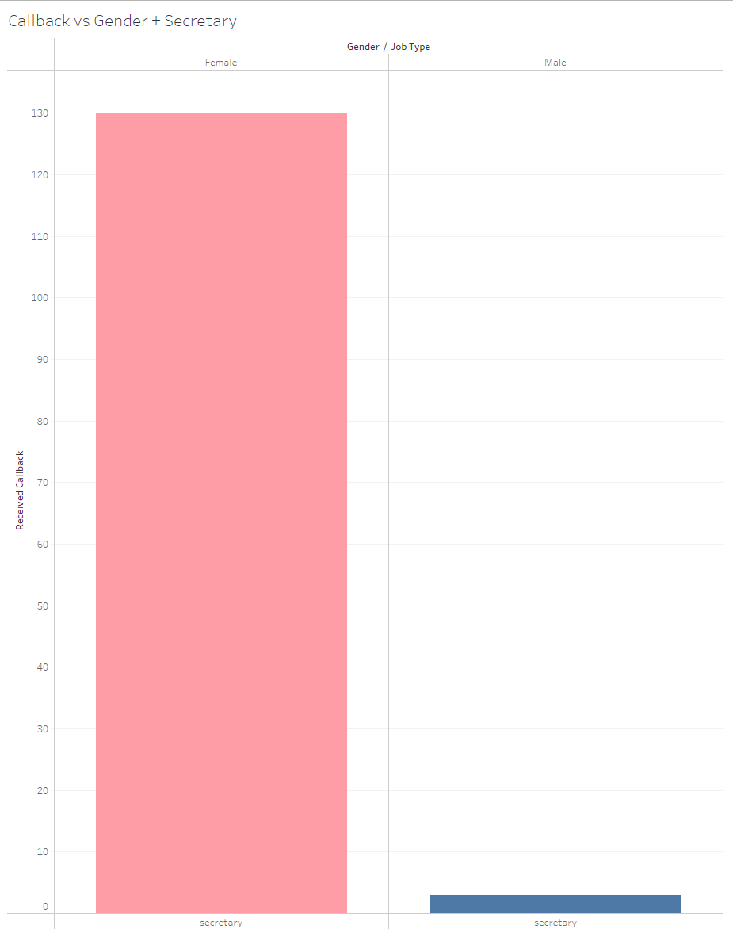
4333.33%
Call Back Factor: Gender + Position (Secretary)

Slide 13
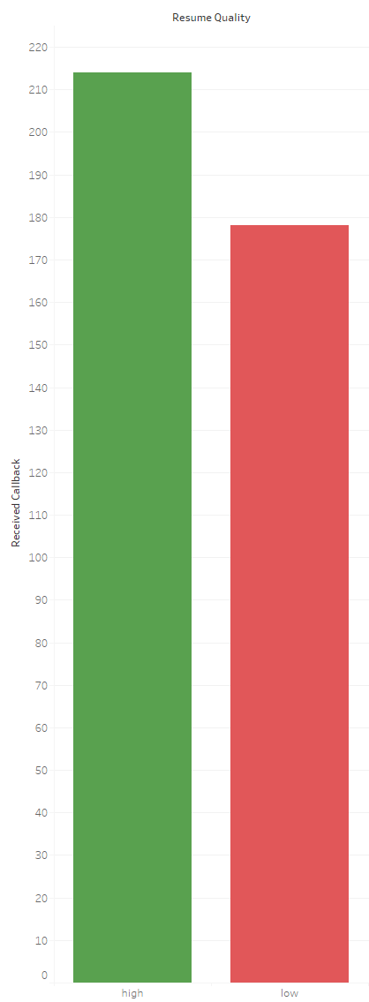
120.22%
Call Back Factor: Resume Quality

Slide 14
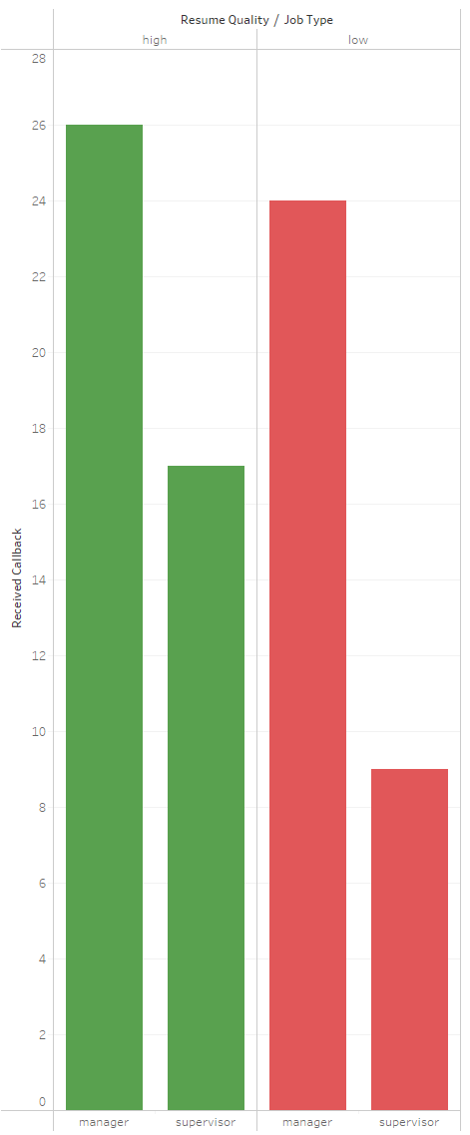
130.30%
Call Back Factor: Resume Quality + Position

Slide 15



Key Takeaways:
Gender came in to play much more than we thought but in the opposite manner. Women received more call backs than men.
Race came in to play a small amount as white applicants received a noticeable amount of call backs more when compared to black applicants.
Positions did not have a large difference except for women and men in secretary rolls where women were OVERWHELMINGLY taken over men.

